Slide 1
Module 6: Introduction to Power Apps

Slide 2
Power Apps Overview

Slide 3
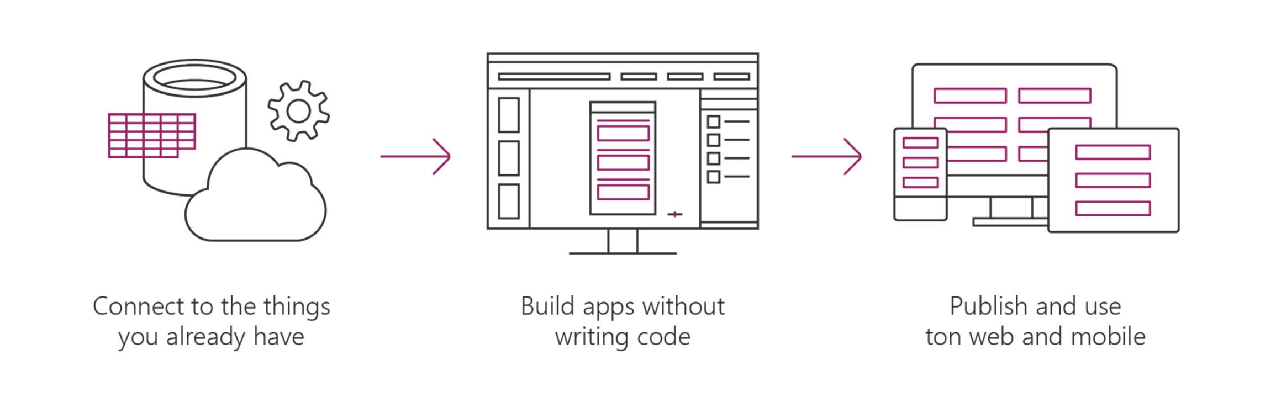
Microsoft Power Apps helps business power-users to create and use custom business apps across platforms.
Connect to data & systems you’re already using; Create the data you need.
Create apps, forms, and workflows without writing code.
Use apps on web and mobile.
Notes:
MSFT PowerApps is a SaaS service for creating and using custom customer business apps across different mobile and web platforms
It can connect to existing enterprise systems and data sources you already have allows you to build LOB apps that utilizing the investment you’ve already made in your existing enterprise systems, without have to duplicate data and thus keeping a ‘clean’ single version ‘of the truth’
PowerApps enables you to build Apps without having to write code. It enables you to build Apps declaratively. With PowerApps, business experts can work more efficiently together with their counterparts in IT and consulting partners, literally on the same page in a visual designer—or solve problems on their own. Through an integration with Microsoft Flow, you can trigger flows right from within apps.
The Apps can be published instantly to co-workers across web, tablets and mobile devices for easy sharing and consumption within your organization.

Slide 4
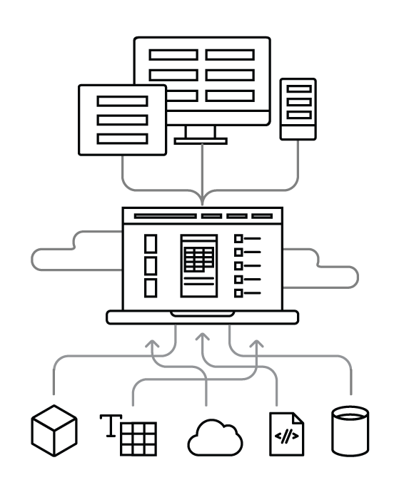
How it works
Use on web and mobile Find and use apps instantly on the web and in Power Apps mobile for iOS and Android.
Power Apps Cloud Publish apps to people in your organization so they can access anywhere.
Create in Power Apps Studio Build apps in a visual experience that shows exactly what you’ll get.
Connections Build apps that interact with your data sources and respect their permissions.
Your data Power Apps connects to a range of data sources and systems, including custom APIs.

Slide 5
Dataverse for Teams
Previously named Project Oakdale

Slide 6
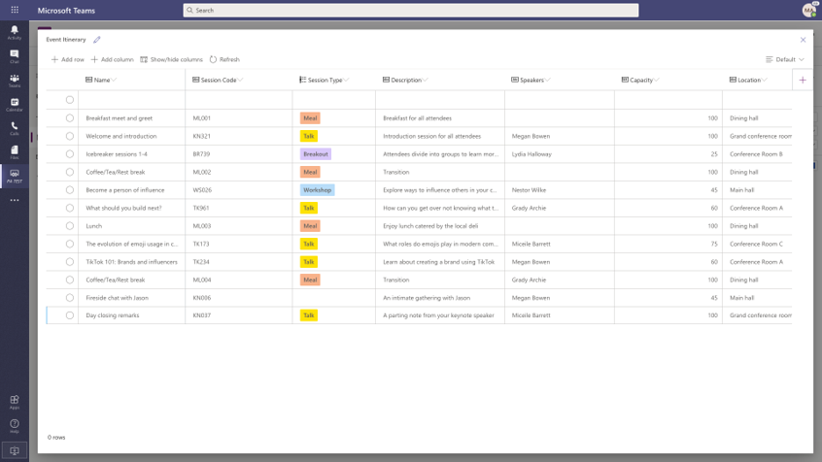
What is it?
Low-code platform
Relational storage, and rich types
Enterprise-grade governance
One-click solution deployment
Notes:
Discuss
Dataverse for Teams delivers built-in:
Low-code data platform for Microsoft Teams
Relational data storage, and rich data types
Relational
File + Image
Find, Filter, Sort
Basic Datatypes
Common Data Model (Coming Soon)
Enterprise-grade governance
Uses Environments (Capacity limits)
Uses Security (Roles)
Capacity enforcement (80% warning, 100% No new apps)
Promote environment to CDS
One-click solution deployment (https://docs.microsoft.com/en-us/powerapps/teams/use-sample-apps-from-teams-store)
Employee ideas Manager and employee apps for campaigns and ideas.
Inspection Manager and user apps for area inspections.
Issue reportingManager and user apps for issue reporting.

Slide 7
When should I use it?
Low-code and no-code within Teams.
Core data capabilities
Storage and rich data types
New visual editor
Enterprise security
Teams licenses.
Promotion to Dataverse (CDS).
2 GB per team, and support for up to 1 million rows
.
.
Notes:
Discuss
Support to build low-code and no-code apps, flows, and chatbots for and within Teams.
Core data capabilities from the same platform behind Microsoft Power Platform and Dynamics 365.
Storage, rich data types with enterprise capabilities, and one-click solution deployment.
A new visual editor that makes it even easier to define and populate table data.
Enterprise security that's easy to use and aligned with the approach used in Teams.
Inclusion in most existing Teams licenses.
Storage of 2 GB per team, and support for up to 1 million rows.
Support for up to 500 teams.
The capability to be promoted to Dataverse.
Mention
Supports Teams Azure AD security group with runtime (JIT) user access and privilege checks.
Auto assignment of System Administrator security role to Teams Owners.
Ability to assign different security roles to Teams Owners and Members.
No security settings management for Business Unit and Teams is required.

Slide 8
When should I not use it
Access
Coding
Data limitations
Environment limitations
Notes:
Discuss
If you require Access from outside of the Team that environment is connected to
Complicated logic or access to API is required
If you require more data then 2GB or over 1 million rows
Exceed the 500 environment limit
Mention
Other choices include
Dataverse
SP Lists

Slide 9
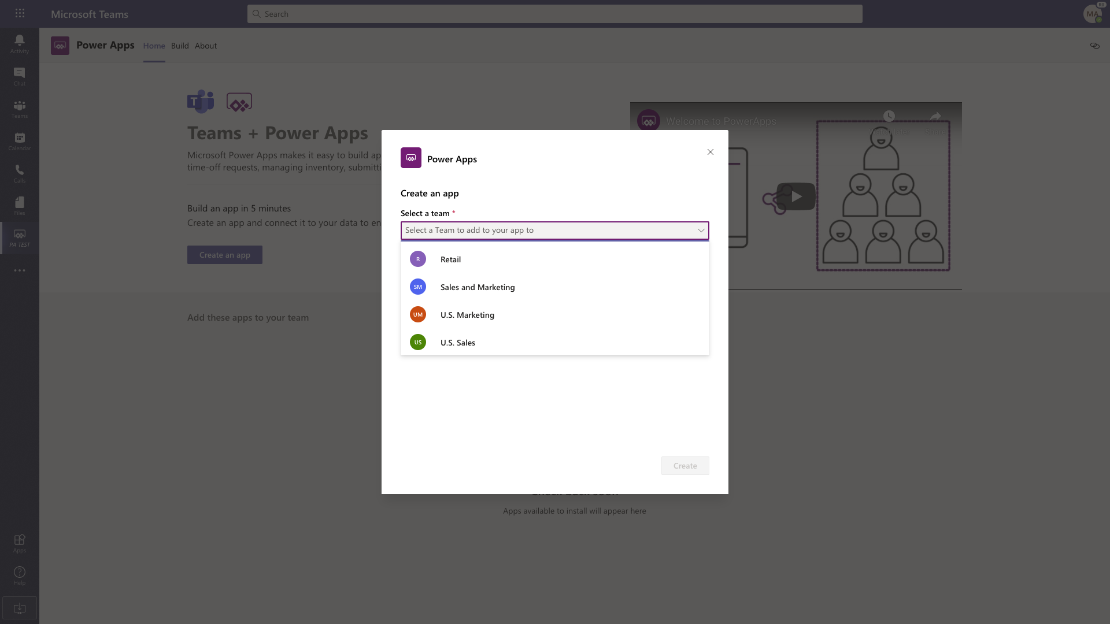
How would I use it
Environment is automatically created for the selected team when you:
1. Create a new Power Apps app in Teams for the first time
2. Install a Power Apps app from the app catalog for the first time
Notes:
Discuss
The Dataverse for Teams environment is automatically created for the selected team when you:
1. Create an app with the new Power Apps app in Teams for the first time
2. Install a Power Apps app from the app catalog for the first time.
Mention
Aligns with the core roles identified in the environment: Owners, Members, and Guests
Access to the environment is restricted just to the Teams owners, members, and guests
Granting access is managed by Teams Owner by adding or removing members
Provides support for files, images, and multiple related tables

Slide 10
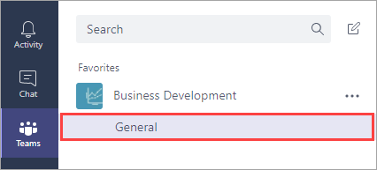
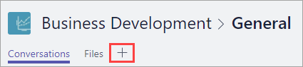
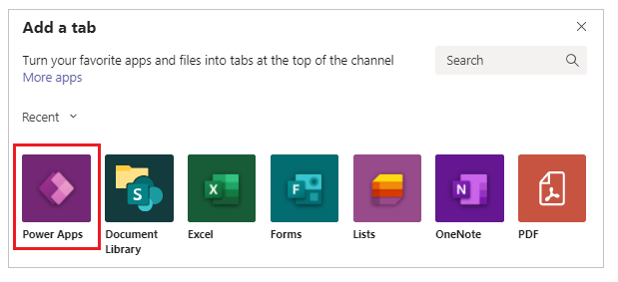
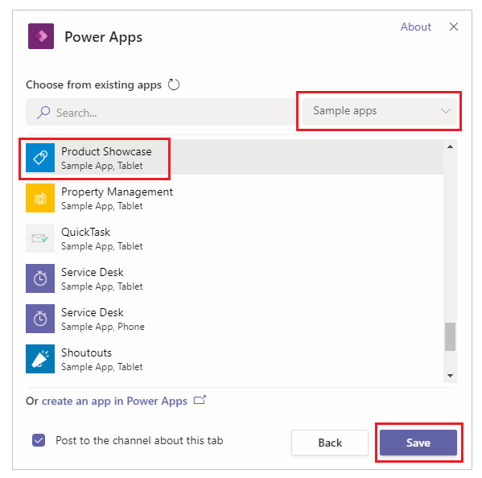
Embed a canvas app as tab app in Teams
In Microsoft Teams, select a team, and a channel under that team. In this example, it's the General channel under the Business Development team.
Choose + to add a tab.
In the Add a tab dialog box, choose Power Apps.
Choose Sample apps > Product Showcase > Save
Notes:
Embed a canvas app as tab app - Power Apps | Microsoft Docs
Embed an app in Teams - Power Apps | Microsoft Docs

Slide 11
Fundamentals

Slide 12
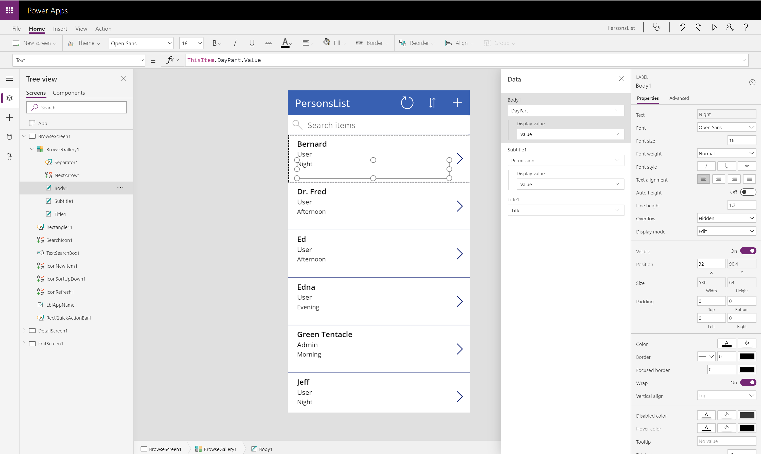
Power Apps Studio
Build business logic into your apps
Craft forms and screens
Power your app through data
Take advantage of device capabilities
Notes:
Discuss:
To access go to: https://make.powerapps.com
Craft forms and screens in a visual designer that helps you see exactly what you’ll get
Take advantage of device capabilities like cameras, GPS, and pen controls
Build business logic into your apps with an Excel-inspired expression language
Connect multiple existing data sources or create your own data to power your app
Mention:
Building useful line-of-business apps without needing to write code is, some of the key highlights through the Power Apps Studio :
A visual designer with a familiar user experience that enable you to build the screens you need to power your App.
You can build validation rules and business logic right into your screen using an Excel-function inspired expression language.
Take advance of the devoice specific sensor capabilities like cameras, GPS and Pen Controls to improve context awareness of the app and build even more powerful apps

Slide 13
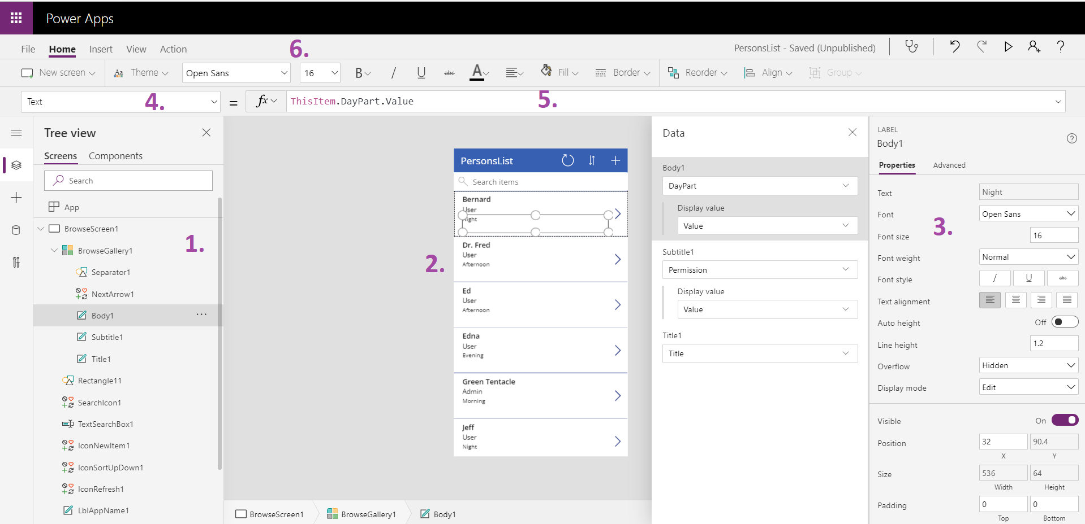
Power Apps Studio components
Notes:
Left hand navigation
Content pane
Right hand pane (options, data sources, etc.)
Dropdown list of properties
Formula bar for selected property
Ribbon
For more information on Power Apps Studio introduction, see: https://powerapps.microsoft.com/en-us/guided-learning/learning-powerapps-parts/

Slide 14
Power Apps Studio
Navigate to Power Apps Portal
Deploy a template app
Explore app in Power Apps Studio

Slide 15
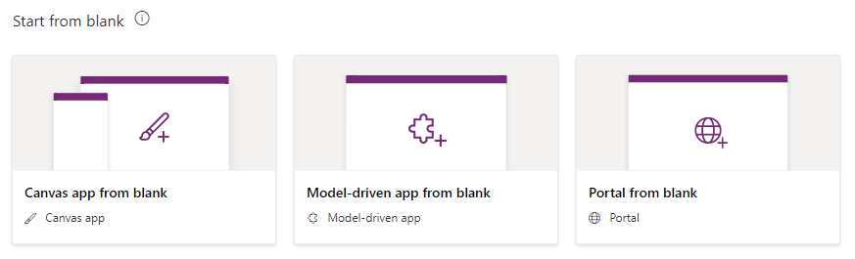
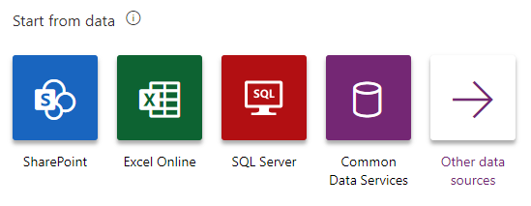
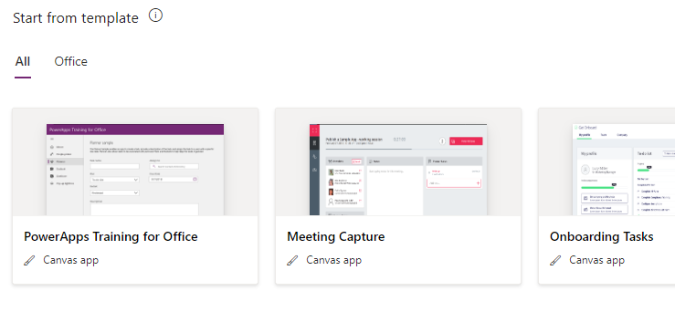
Creating an App
3 options for creating new apps:
Start from scratch (create from blank)
Start from data
Start from a template
Notes:
Create an app from template uses predesigned templates to get the app creator started building an application.
Create an app from data allows the app creator to connect to a predefined set of connectors (SharePoint, SQL Server, Oracle, Salesforce, Excel files on multiple cloud services, and more). At the time of writing only phone layouts can be used for
Create an app from scratch allows the app creator to design and connect to data as they see fit.
For more information on Create an app from a template, see: https://powerapps.microsoft.com/en-us/tutorials/get-started-test-drive/
For more information on Create an app from data, see: https://powerapps.microsoft.com/en-us/guided-learning/learning-create-first-app-powerapps/
For more information on Create an app from scratch, see: https://powerapps.microsoft.com/en-us/tutorials/get-started-create-from-blank/

Slide 16
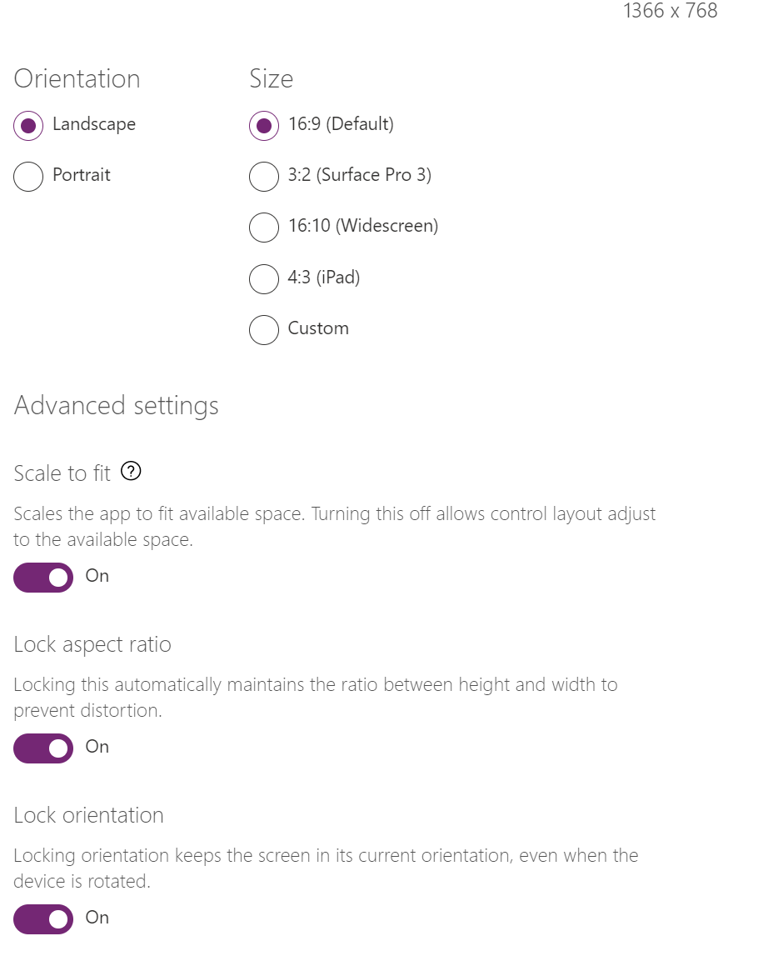
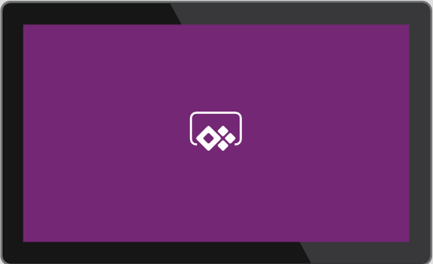
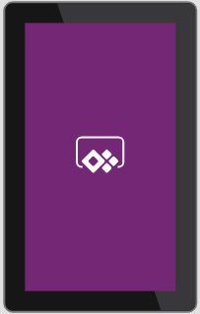
Layout options
Screen size + Orientation
Phone
Tablet
Notes:
Discuss:
Power Apps assumes mobile-first development, and as such, asks you to choose between an app optimized for phone or tablet screen size, and then orientation.
Once you make this choice, you cannot go back and change it, so it is a very important first decision. It is recommended to start with a phone layout, as the images, fonts, and UI controls will scale up when viewed on a tablet and look acceptable. If you start with Tablet, and then view on a phone, fonts and UI elements will shrink proportionately on the phone and may be too small to read effectively.
You can also choose the orientation of the app, and whether the app is locked to that orientation and aspect ratio.
Apps can adjust UI controls and elements to changing orientations by using formulas based on the ActiveScreen.Width or ActiveScreen.Height calculations.

Slide 17
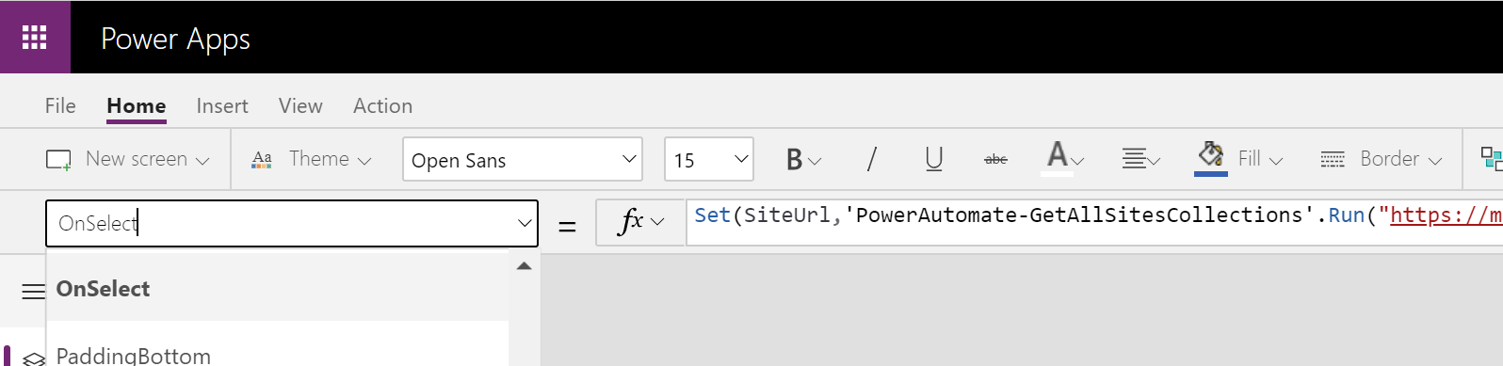
The formula bar
Choose the control/screen property
Control it with formulas
Notes:
This example shows us the properties for a control or screen in the dropdown on the left. On the right, we can see the associated formula bar for that property. In this example, we’ve placed a Navigate() formula for the OnSelect event/property of a Button control, telling it to navigate to the “Planners” screen.

Slide 18
SharePoint List as data repository
Containers for storing content within a SharePoint site
Lists organize content in the form of items (with or without attachments)
Libraries organize content in the form of documents or files
Notes:
Introduction to lists - SharePoint (microsoft.com)

Slide 19
Build a canvas app from blank
Objectives
In this lab, you will be able to:
Create Power App canvas app from blank
• Create SharePoint lists
Scenario
The organization needs to replace legacy apps and has decided to onboard Power Apps as a platform. We will be learning how to create those apps as Citizen Developers.
Notes:
See lab file M7_PowerApps_Introduction to Power Apps.docx and complete all tasks.

